Slide 1
MP4 Final presentation
By Derek, Michal, and Max

Slide 2

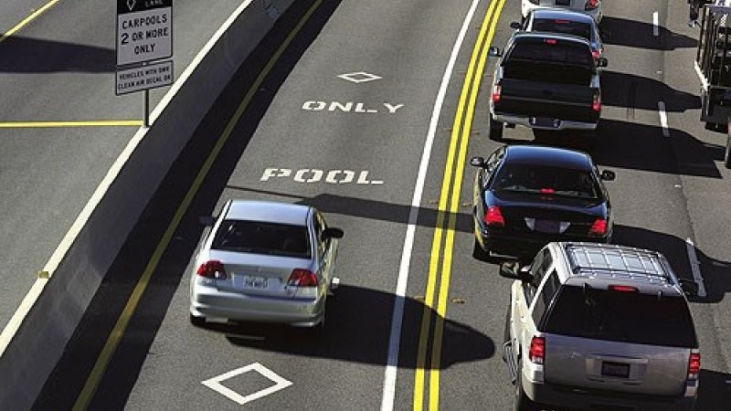



Unique Design Considerations
evict A evict B
Complimentary features:
pLRU
probability is your friend
Eviction Write buffer
trapeze net for caches.
L2 cache
carpool lane
Pipeline L1 caches
no need to wait for everyone’s food to be ready if your food is.
Tournament branch predictor
more robust branch prediction
Return address stack
exploit predictability
extra care?
L2
EWB
Temporary storage between L2 and main memory.
MAT(L1) < MAT(L2) << MAT(Memory)
Notes:
pLRU
evict entry that is least likely to be relevant to current execution path/context
reduces hardware complexity by using a binary tree.
Much faster lookup times.
Eviction Write buffer
register (temporary) for dirty evicted blocks from L2.
no need to perform write back before serving a miss
Cache can reuse unallocated line before knowing if dirty block evicted.
decouples dirty writes and misses
L2 cache
retains repeated access patterns.
extension to L1.
reduce bus congestion.
bigger, but slower than L1.
Pipeline L1 caches
Allow for consecutive (outstanding) misses to served
Latency hiding
If L1 very large, could theoretically yield large benefits.
Serve data that is ready while waiting for (some other) data to be available
Tournament Branch Predictor
infer branch predictions before true outcome known (early in pipeline)
improves performance if correct
keep metabits based on previous execution flows.
prediction := f(pattern_history_table[pc[5:2]], tournament_counter)
next state of tournament predictor = f(prediction,actual value)
easier to decide path when guided by a “map”
update local/global predictors after outcome known (later in pipeline)
implement using counters
direction of count depends on correctness of prediction
use local/global history
maintain different suffix bits for pattern history table entries.
BTB hits mean taken/NT known in IF stage. Eliminate wasted cycles for decoding branch target address in/after ID stage.
decision based on pc_out solely.
RAS
stores address to resume execution from after function call returns.
simplifies logic for TBP when jal/jalr since branch misprediction converted into hits
Hazards: cannot pop an empty stack, jalr used by caller/callee. Obey/account for calling convention.

Slide 3
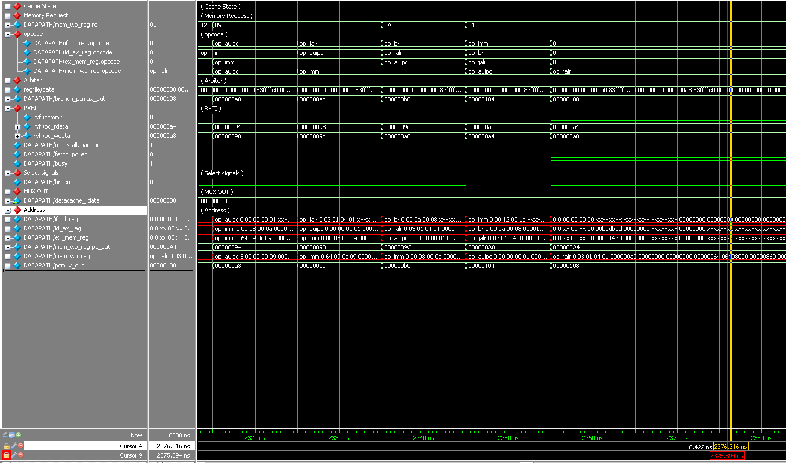
Quantitative
results
 | Time (ns) | Power (mW) | Score
Comp1 | 655645 | 512.14 | 3.787e-11
Comp2 | 4299205 | 485.32 | 9.0834e-9
Comp3 | 3616065 | 471.10 | 4.94365e-9
Geometric Mean: 1.193502e-9
before
after
Notes:
Why does power decrease for comp2/comp3? better use of the pipeline. Some pipeline stages are clock-gated depending on if pipeline being flushed or not.
Lots of combinational logic in datapath and submodules. Potential for glitches, even after clock gating.

Slide 4
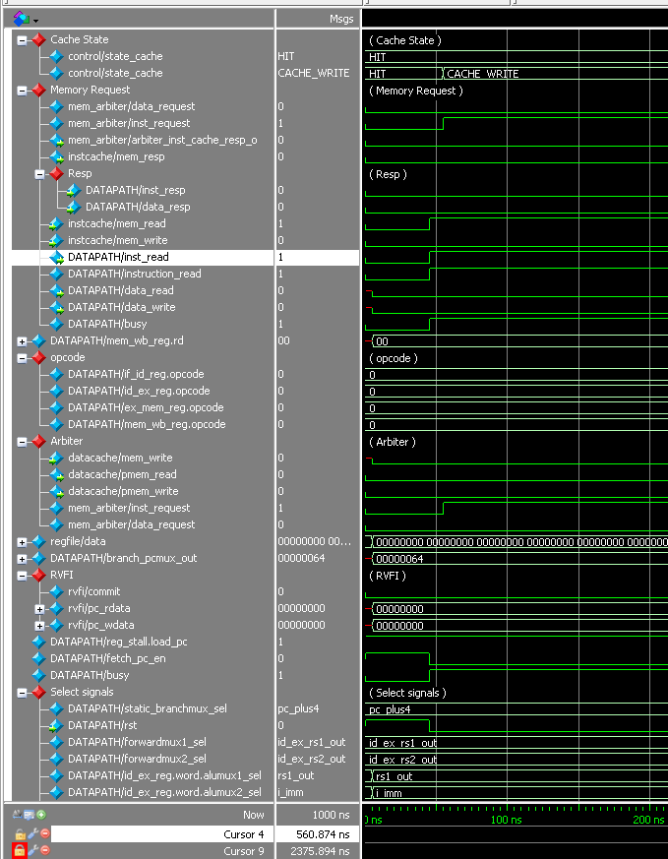

If we had a time machine to 3/18/21
Bugs, lots and lots of bugs(took more time than should have):
Stores after loads hazard
Arbiter(Easiest = Deception, Complex = error-prone)
Control ROM
RISC-V Manual is King(Instruction specific bugs)
What We learned
Occam’s Razor: simpler = better = easier debug
CPU designs are complicated. Keep it simple.
Communication is important
Everyone has to be on the same page.
Explaining Skills: who does what best
Debugging Skills
Waveforms are tricky and time consuming(Debugging checkpoint code is pain :()
Tunnel vision
“Give me six hours to chop down a tree and I will spend the first four sharpening the axe.”
Read the Docs carefully!(Even if it is painful and boring)
RISC-V Manual
MP4 Docs
http://chipverify.com/systemverilog/systemverilog-tutorial
Avoid Assumptions
Didn’t thoroughly examine intermediate/final register contents, assumed 600d600d = GOOD!
Beware undefined/inferred behavior
Programming for hardware != Programming for software
(10s to add waves of interest)*(1000 runs) = 2.8 hrs clicking labels
Notes:
Bugs: simpler = better = easier debug
CPU designs are complicated. Keep it simple.
Occam’s Razor: simpler = better = easier debug
CPU designs are complicated. Keep it simple.
Write test benches with modules.
easy to test/verify modules independently if highly modular design.
sound verification logic implies sound design logic
eliminate bugs before integrating

Slide 5


Any Questions?

